Slide 1


Amesbury CDBG Program
August 5, 2021
Public Hearing

Slide 2
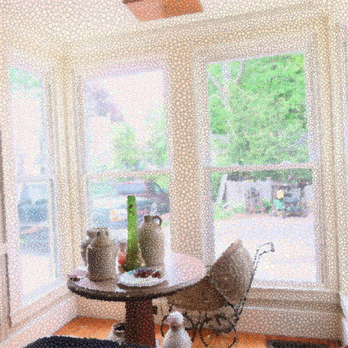
Agenda
Welcome
CDBG Program in Amesbury
FY 2021 CDBG Grant Application Discussion
Question/Comments
Adjourn
Notes:
Previous numbers - update with current numbers for PSS and HR
Timeline for this years process
Show website
Announce the housing rehab funds available - ideas for how to get the word out?
Potential projects
Other ideas?

Slide 3

What is CDBG?
CDBG = Community Development Block Grant. Program of the U.S. Housing and Urban Development
Mission is to develop viable urban communities by providing decent housing and a suitable living environment, and by expanding economic opportunities, principally for low- and moderate-income persons.

Slide 4
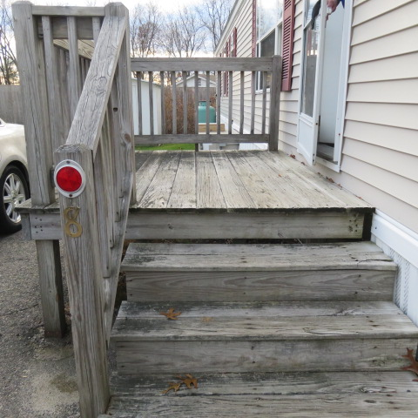
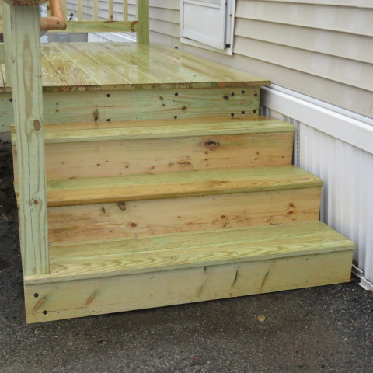
What Does CDBG Fund?
Housing Rehabilitation
Community Economic Development Projects
Signs/façade improvements
Streetscape improvements
Public Facilities and Infrastructure
Streets and sidewalks
Neighborhood facilities
Architectural barriers
Planning
Public Social Services
Program delivery and costs (local non-profits and municipal)

Slide 5
CDBG Program in Amesbury
Total Funds received since 2008:
$3.35 million
~2,500 residents assisted
Housing Rehabilitation
70 units rehabilitated since 2015
Community Economic Development Projects
Signs/façade improvements downtown
Public Facilities and Infrastructure
Streets and sidewalks – Aubin/Nason Neighborhood improvements
Public Social Services
Our Neighbors’ Table, Pettingill House, Jeanne Geiger Crisis Center, Boys and Girls Club, Amesbury Public Schools

Slide 6
Amesbury CDBG Program
Total Funds received since 2008: $3.35 million

Slide 7



Amesbury CDBG Program – FY 2019 Status
1. Housing Rehabilitation: Rehab 10 units
Primarily seniors
Heating, roofs, windows, mold, safety features
10 units in progress
2. Architectural Barriers: Install new accessible ramp at City Hall
Ramp to be installed in September
3. Public Social Services: Food Pantry, Domestic Violence Prevention, Emergency Financial Assistance
Our Neighbors’ Table, Pettingill House and Jeanne Geiger Crisis Center
Funds spent

Slide 8
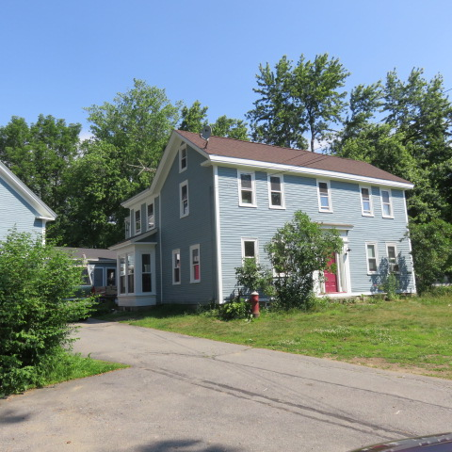
Amesbury CDBG Program – FY 2020
Received $550,000
$400K less than usual
Begin work in August 2021
Scope:
1. Housing Rehab: Rehab ~10 units. Funds available soon!
2. Public Social Services: Tuition Assistance for After-School Program
Brought CDBG Program back “in-house”
Hired Shauna Becotte: Community Development and Housing Manager
More collaboration and forward thinking for the program
Update website with more timely information
Coordinate with Communications Director to promote program

Slide 9
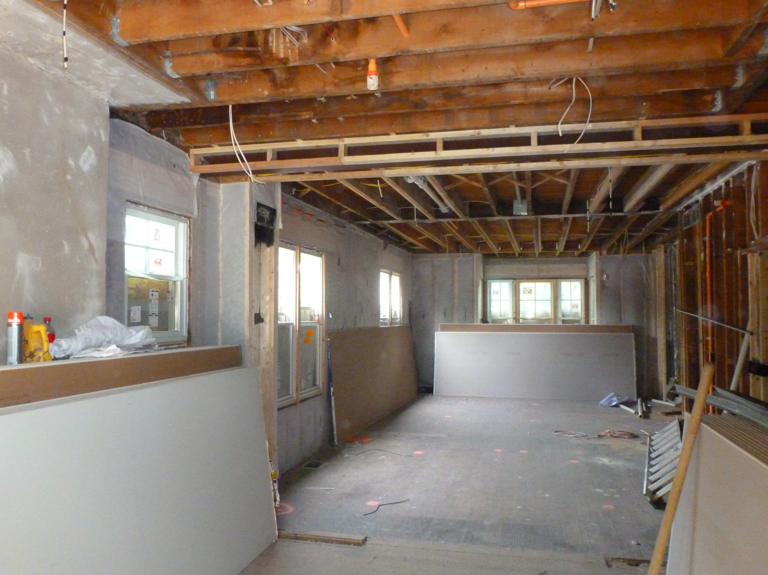
Getting the word out for Housing Rehab
Posted on OCED website
Brochure available
Council on Aging Newsletter
Churches
Others….?
https://www.amesburyma.gov/community-economic-development/pages/amesbury-housing-rehabilitation-program-cdbg

Slide 10

Amesbury’s CDBG 2021 Application
Due September 10th

Slide 11
CDBG FY 2021 Timeline
June 17, 2021
July 8, 2021
Launch Application for Social Service Agencies
July 26, 2021
Deadline for SSA Applications
Release of FY2021 Notice of Funding
August 5, 2021
August 9-18, 2021
CDBG Planning Advisory Committee* Assesses Feedback and Finalize Application Projects. Mayor is final say.
August 19 – September 10, 2021
Write Grant Proposal and Submit to DHCD
Public Hearing with Community
* CDBG Planning Advisory Committee =
Councilor Adrienne Lennon, City Council
Keith Ratner, Planning Board
Angela Cleveland, OCED
Shauna Becotte, OCED

Slide 12

Potential Projects for FY 2021
Housing Rehabilitation
Rehabilitate ~10 homes
Work with Housing Authority to rehabilitate Powow Villa
Social Service Agencies
Community Action Inc. – support Empowerment Essex County
Our Neighbors’ Table – support grocery programs
Pettengill House - emergency financial stabilization assistance
YWCA – subsidies for Children’s Center Program
Other ideas???
Notes:
Community Action: this program provides financial empowerment programs including Budget Buddies, Money Smart, Cooking Matters, and First Time Homebuyers subsidies
ONT: provide approximately 502,700 meals to 2,000 residents of Amesbury through its grocery programs
Pettengill: provide emergency financial stabilization assistance up to $1,500 per household with the goal of improving
stabilization and wellbeing for identified individuals, children, and families.
YWCA: this will help Amesbury families afford to send their children to daycare, putting families back to work

Slide 13




Thank You!
Angela Cleveland, AICP
Shauna Becotte
978-388-8110
oced@amesburyma.gov

