Slide 1
Amesbury Council on Aging: Key Findings from the 2023 Community Needs Assessment
By: Erin Connors and Kate Quinn
UMass Lowell MPH Dietetic graduate students

Slide 2
Introduction
Community Needs Assessment of 2023 was conducted in the Spring of 2023 and distributed via mail to over 6,600 Amesbury residents ages 55 years and older
333 respondents completed the survey
Data from this survey represents respondent experiences from 2022

Slide 3
2023 Community Needs Assessment: Goals
To better understand the needs of the community in order to enhance Council on Aging programs and services
To determine perceived needs of this population
To stratify needs by age
To evaluate mental health needs

Slide 4

Why does the council on aging matter?
"I hope you will redo this survey in the future. I am very fortunate presently to be independent & with a great support system, but with aging this could very well change"
- Respondent from the 2023 Community Needs Assessment
(Amesbury Council on Aging, 2023)
Notes:
"I hope you will redo this survey in the future. I am very fortunate presently to be independent & with a great support system, but with aging this could very well change"
I have had a wonderful experience and have grown immensely from all the new friends I have made and found ways to occupy myself in the programs. As well, I am volunteering and putting time back into the community.
The COA seems to be hitting all the marks possible to address senior issues.
I came to Center in Fall of 2022 after losing my husband, my dog and Covid. I moved to Amesbury to be closer to my daughter. I have met so many wonderful people and feel 10 years younger!

Slide 5
Table of contents
I. Data Collection Methods and Results
II. Key Findings
III. Recommendations Based on Key Findings
IV. Collecting New Data
V. Challenges & Acknowledgements
VI. References
Notes:
Quantitative and Qualitative Data from 2023 Needs Assessment:
Respondent Demographics
How many respondents are using COA services?
How do respondents hear about COA services?
Key Findings:
Activities
Food
Housing
Transportation
Recommendations Based on Key Findings:
Newsletter and Flyers
Volunteer opportunities
Pair activity request with volunteer skill
Home repair resources
Cooking classes and grocery tips
Transportation opportunities
Collecting New Data
References

Slide 6
How we collected data
Sampling was from a report from the City Clerk's Office of residents 55 years or older
Send a hard copy survey to residents aged 55 years or older
Participant had the option of returning their surveys
By US mail to the Council on Aging Center
By dropping it off to the center in person
By using the link of the COA to submit responses

Slide 7
Respondent demographics
Notes:
Age -all respondents were 55% of older
Gross HH Income -19.75% under $25,000, 7.4% over 100,000, 39.5% $25,001-50,000, 18.5% 50,001-75,000, 11.7% 75,001-100,00
Veterans -10% are veterans
Working - yes 19%, no 76%, retired 64%
Race -0.5% are American Indian or Alaskan Native, 0.5% are Asian, 1.6% are Black or African American, 96% are Caucasian or White, 1% are Hispanic or Latino

Slide 8
Respondent Income
Notes:
K Finical Assistance
CM - I have experienced financial difficulties that have caused me distress
Age -all respondents were 55% of older
Gross HH Income -19.75% under $25,000, 7.4% over 100,000, 39.5% $25,001-50,000, 18.5% 50,001-75,000, 11.7% 75,001-100,00
Veterans -10% are veterans
Working - yes 19%, no 76%, retired 64%
Race -0.5% are American Indian or Alaskan Native, 0.5% are Asian, 1.6% are Black or African American, 96% are Caucasian or White, 1% are Hispanic or Latino

Slide 9
How many Respondents are using council on Aging services?

Slide 10
How do respondents hear about council on aging services?
How do respondents hear about COA services?
9% of respondents hear through the Council on Aging website
100% of respondents hear through the newsletter
28% of respondents hear through announcements during programming
Friends
Email
Newsletter & Flyer
Phone calls

Slide 11
Key Findings: Need for Legal/Financial assistance
70 respondents described different types of advice they need:
Property rights
Estate planning
Trust and Will
Taxes and housing
Divorce
Financial and retirement
Notes:
K Finical Assistance
Age -all respondents were 55% of older
Gross HH Income -19.75% under $25,000, 7.4% over 100,000, 39.5% $25,001-50,000, 18.5% 50,001-75,000, 11.7% 75,001-100,00
Veterans -10% are veterans
Working - yes 19%, no 76%, retired 64%
Race -0.5% are American Indian or Alaskan Native, 0.5% are Asian, 1.6% are Black or African American, 96% are Caucasian or White, 1% are Hispanic or Latino

Slide 12
Financial services program satisfaction
Notes:
K Finical Assistance
CM - I have experienced financial difficulties that have caused me distress
Age -all respondents were 55% of older
Gross HH Income -19.75% under $25,000, 7.4% over 100,000, 39.5% $25,001-50,000, 18.5% 50,001-75,000, 11.7% 75,001-100,00
Veterans -10% are veterans
Working - yes 19%, no 76%, retired 64%
Race -0.5% are American Indian or Alaskan Native, 0.5% are Asian, 1.6% are Black or African American, 96% are Caucasian or White, 1% are Hispanic or Latino

Slide 13
Key Findings: Mental Health
27% of respondents have experienced a period of hopelessness or sadness that felt overwhelming
82% of respondents have never struggled to find professional help
32% of respondents have sometimes experienced trauma that causes them distress
"Grief- I lost my spouse three years ago. I am still sad"
“I have learned to care for myself and am committed to good mental health.”
“I have sometimes experienced a period of worry or anxiety that felt overwhelming.”

Slide 14
Key findings: excellent ratings of events and activities
91% of respondents who played games rated them good or excellent
“Enjoy Bingo, dinners with entertainment and help available”
93% of respondents who took advantage of learning opportunities rated them good or excellent
“The center is a place to get answers about what is going on in town for seniors, where to get help and where to meet people.”
98% of respondents rated special events good or excellent
"Enjoy breakfast with chiefs; Wedding line dancing; Chair yoga BUT TOO EARLY in AM (yoga)"
96% of respondents rated wellness programs good or excellent
"I love the exercise class with Paula Pressler. She is awesome. So far, anything I have attended has been wonderful. Andrew Suggs is awesome!!"

Slide 15
Feedback on the Staff
“I am very happy here, there is so much available to seniors! staff superior, I see many smiles and hear wonderful comments”
“Welcoming staff & obviously effort to have lots of programs & services for people. Well done.”
“Staffing, staff attitudes, programs, pretty much everything!”

Slide 16
Key findings: difficulty with food access, grocery shopping, and food preparation
23% of respondents have trouble getting around the store
21% of respondents sometimes have trouble paying for groceries

Slide 17
Key findings: Difficultly affording housing expenses and repairs
“as a homeowner (aging) repairs seem to becoming somewhat of a problem. Very expensive and difficult to find people who will ever come.”
20% of respondents have difficulty paying for housing
“housing has gotten so expensive, we need more elder housing, we need to upgrade current elder housing”
22% of respondents feel unsure about where they will live in the next year
“Given the other expenses in this region-utilities, taxes, fees, consumer goods, fuel; it has become challenging for many. While housing is and can be a challenge-very little else is affordable in this area”
45% of respondents have trouble or difficulty with repair/upkeep of their homes (finding someone to do work, paying for the work, etc.)
40% of respondents are living alone
"I have learned to care for myself and am committed to good mental health."

Slide 18
Key findings: transportation access and limitations
22% of respondents either sometimes or frequently use the COA van
78% of respondents never use the COA van
Major themes in survey results:
Respondents are looking for more opportunities for transportation to out of town doctor’s appointments
Boston, Danvers Cancer Center, etc.

Slide 19
Recommendations based on key findings
Presented below are recommendations for next steps to improve Amesbury COA services based on key findings above

Slide 20
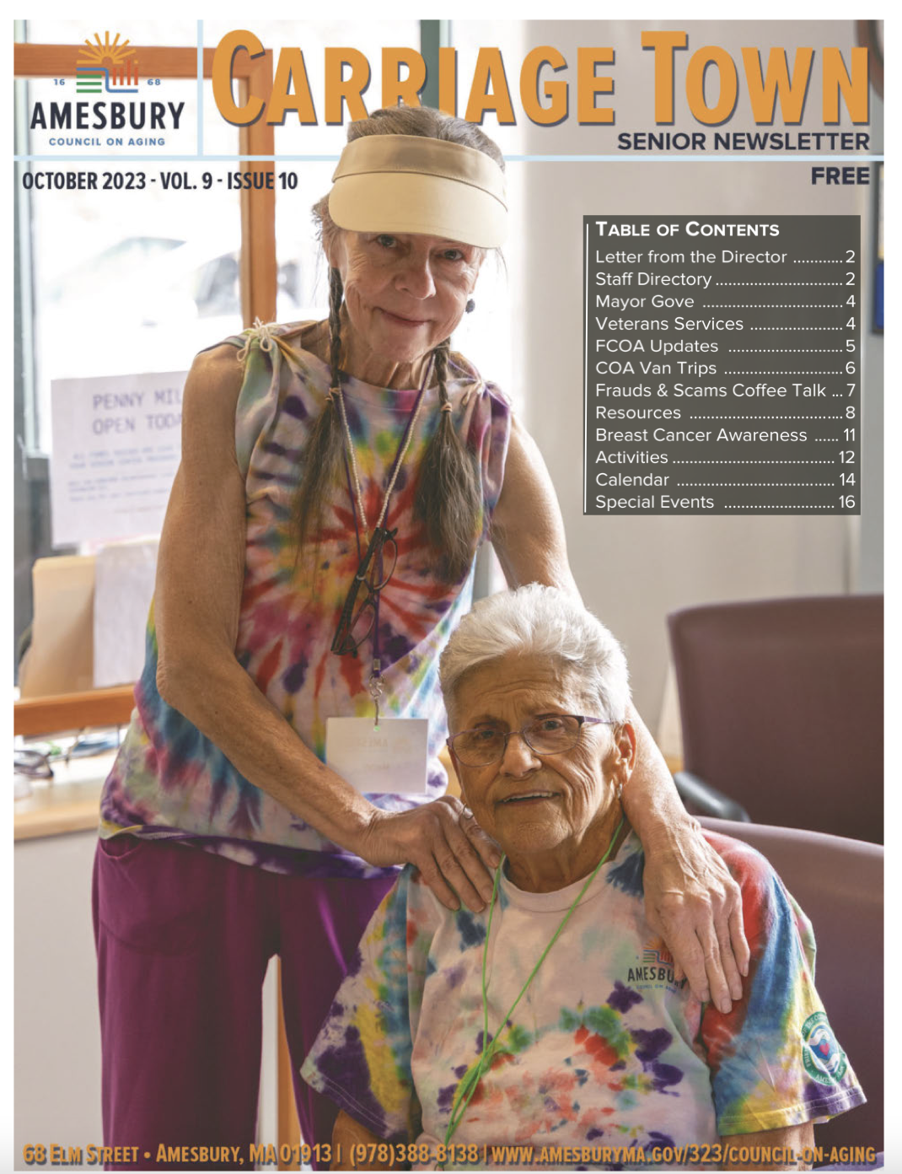
Recommendation: Distribute Newsletter and Flyers To new Locations
100% of respondents hear about events through the newsletter
Improve outreach with advertisement of newsletters and flyers in new locations:
-churches
-public transportation
-city hall
-newsletter to all residents over 55
-grocery stores
(Amesbury Council on Aging, 2023)

Slide 21

Recommendation: utilize volunteer skills to offer new opportunities
There is a current overlap between activities people want to see more of and skills volunteers are willing to share.
-Contact respondents with skills that match community interests
-Have an “idea board” where members can post what they’d like to see next
-Pass around sign-up sheet at events to book in facilitators for new events

Slide 22
Pair Activity Request with volunteer skills
What respondents would like to see:
Volunteer professional skills offered:
Classes on nutrition and cooking
Cooking classes and meal prep
Classes on computer and technology skills
Social support
Classes on health insurance (Medicaid/Medicare) and classes supporting health conditions
Experience working in healthcare (registered nurse, insurance agency, medical practice, etc.)
Experience working as a receptionist with computer skills
Peer-to-peer assistance
Notes:
Walking club
Arts and crafts
Computer skills
Lifelong learning classes with different topics
Groups to discuss health topics (multiple medical professionals willing to share)

Slide 23

Recommendation: provide resources for housing repairs
-Assemble a small group to share resources on home repairs and upkeep
-Inclusion of short list of reliable contractors in the newsletter
-Breakfast with the contractors (electricians, plumbers, and mechanics can cover relevant home care topics)
-Renting out basic house repair tools

Slide 24

Recommendation: cooking classes and grocery trips
Meals on a budget:
-Expand cooking classes led by members to include basic cooking skills and affordable recipes
Grocery store tours:
-Grocery groups could shop together weekly to assist those who have a hard time getting groceries on their own

Slide 25
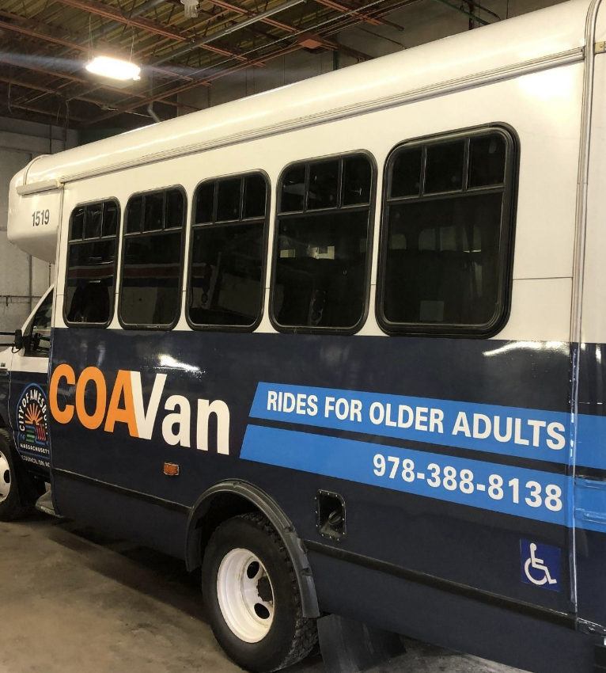
Recommendation: expand transportation opportunities
Further advertise COA van opportunities:
-Respondents expressed need for transportation to out of town doctor's appointments and hospitals
-Post van schedule on newsletter and website
(Amesbury Council on Aging, 2023)

Slide 26

Collecting Additional data
Additional data collection methods could include:
-Focus groups of 5-7 residents to understand needs based on priority areas (food security, housing repairs, transportation, etc.)
-Key informant interviews to gain various perspectives on resources available to the COA (ex: COA members, volunteers, and staff)

Slide 27
Challenges
According to the National Research Center, Inc., an average response rate for a Citizens survey, mailed and conducted online is 20-30%. Amesbury’s COA Needs Assessment Survey had a 5% response rate. The Council on Aging board and Director suspect the low response rate could be due to the inability to initially mail all surveys out to the entire group of 55 and older adults. Eventually, the second group from the Clerk’s list of residents was mailed but the momentum may have been affected. A second theory is the survey may have needed to be shortened. The experts suggest, having a well-designed survey, providing financial remunerations, sending personalized invitations, offering regular reminders, and using more than one recruitment strategy are evidence-based approaches to improve response rates. (NIH.gov May 25, 2023).

Slide 28
Acknowledgments
Although the response rate was low, the feedback we received was helpful to better understand the needs of the community and establish future goals. The COA Director and her board are appreciative to those that completed the survey for their insight and opinions. The Director wishes to thank the Age Friendly Task Force for their contribution, the Council on Aging Staff, Board, and other volunteers for helping to create and distribute the 6600 Needs Assessments. And to UMass Lowell’s Public Health Department, specifically Dr. Sabrina Noel and her students, Kyle Fahey, Erin Connors and Kate Quinn for analyzing the data and creating a report to share with the community. We will learn, adjust, repeat!

Slide 29
References
Amesbury Council on Aging. (2023, September 11). 2023 Needs Assessment Completed- Combination of Online & Manual Responses- MFM Version #1-Corrected 9.6.23.
Amesbury Council on Aging. (2023, September 15). Council on Aging. Amesburyma.gov. https://www.amesburyma.gov/323/Council-on-Aging
Amesbury Council on Aging. (2023, September 15). Carriage Town Senior Newsletter. Mycommunityonline.com. https://container.mycommunityonline.com/bulletins/06/5290/20231001N.pdf
Amesbury Council on Aging. (2023, September 29). Council on Aging to Launch COAVan in April. Amesburyma.gov. https://www.amesburyma.gov/CivicAlerts.aspx?AID=19

