Slide 1


FY25 Classification Hearing
Assessor’s Office
Diana Caswell, Chief Assessor November 12, 2024

Slide 2


The Purpose of Tax Classification Hearing
This classification hearing is held to determine the allocation of the local property tax to be borne by the four classes of real property, Residential, Open, Commercial, Industrial, and Personal Property, for Fiscal Year 2025. The Board of Assessors applies these percentages to the individual property classes (M.G.L. Chapter 40, section 56). At the completion of the public hearing, the City Council will vote on four separate items in order to establish the tax burdens for each class of property.
THE SELECTION OF A RESIDENTIAL FACTOR
OPEN SPACE DISCOUNT
RESIDENTIAL EXEMPTION
COMMERCIAL EXEMPTION
It is anticipated that the vote will take place at the City Council meeting held on November 26th

Slide 3
1) The Selection of a Residential Factor
In deciding the allocation for the local property tax, a residential factor must be adopted by the City Council and the Mayor. The residential factor is used to determine the percentage of the tax levy that is applied to each class of real and personal property.
The minimum residential factor for FY25 is .935
This factor allows to shift the burden towards Commercial, Industrial and Personal Property taxpayers to a maximum of 150%
A vote for a factor of 1 will establish a single tax rate for all classes of property. Any other residential factor will result in a split tax rate.

Slide 4
Our office is required to assess property at 100% full and fair cash valuation. Our values are reflected as of January 1, 2024. To obtain this, we primarily utilize sales from 2023.
The Department of Revenue reviews and approves our values annually.
AVERAGE VALUE FOR INFORMATION PURPOSES
 | # of Parcels | FY25 Value | FY24 Value | % Change | $ Difference
Single Family | 3531 | 626,318 | 582,514 | 7.52% | 43,804
Condo | 1728 | 403,142 | 367,269 | 9.77% | 35,873
Two Family | 314 | 582,176 | 557,085 | 4.50% | 25,091
Three Family | 66 | 698,959 | 686,170 | 1.86% | 12,789
Apartment | 59 | 3,232,313 | 3,181,159 | 1.61% | 51,154
Commercial | 218 | 824,323 | 818,796 | 0.68% | 5,527
Industrial | 84 | 1,574,009 | 1,457,196 | 8.02% | 111,813
Personal Property | 217 | 488,865 | 400,627 | 22.03% | 88,238

Slide 5

NEW GROWTH
Additions to the tax base from new construction, property improvement, new businesses, and new taxable personal property
NEW GROWTH
Single Family |  | 8,902,000
Condo |  | 24,512,250
2-3 Family |  | 996,400
Commercial |  | 1,282,300
Personal Property |  | 5,024,952
Residential Growth Total $35,765,840 = $559,378 Tax dollars
C.I.P. Growth Total $7,121,152 = $111,375 Tax dollars
(C.I.P. – commercial, industrial & personal property)
GRAND TOTAL OF TAX DOLLARS GAINED $670,753

Slide 6
FISCAL YEAR 2025 LEVY CALCULATIONS
LEVY LIMIT
Maximum dollar amount a community can raise in a fiscal year. (prior years levy + 2 ½% + new growth + debt exclusion)
EXCESS LEVY CAPACITY
Difference between the levy and the levy limit
DEBT EXCLUSION
A temporary increase to the levy to pay for capital projects as voted on
LEVY
Revenue raised through real and personal property taxes.
FISCAL YEAR 2024 LEVY LIMIT | $54,627,342
PLUS 2.5% | $1,365,684
PLUS FY25 NEW GROWTH | $670,753
TOTAL 2025 LEVY LIMIT | $56,663,779
PLUS DEBT EXCLUSION | $2,937,772
TOTAL LEVY CAPACITY | $59,601,551
ESTIMATED LEVY | $59,428,567
EXCESS LEVY CAPACITY | $172,984

Slide 7
AT A FACTOR OF 1
GENERAL INFORMATION – FY 2025 AT AN ESTIMATED TAX RATE OF $15.30 PER THOUSAND
The average single-family bill will be approximately $9,583, an estimated annual increased $472 - $118 per quarter
The average condo bill will be approximately $6,6168, an estimated annual increase of $424 - $106 per quarter
The median single-family bill will be approximately $8,45, an estimated annual increase of $418 - $104.50 per quarter

Slide 8
The tax rate is the levy divided by the total assessed valuation, known as the Uniform (or Single) Tax Rate. Under this rate each class of property pays a share of the levy equal to its share in the total city value.
The projected tax rate used in this report is estimated for FY25 at $15.30 per thousand.
FY25 tax rate is pending Department of Revenue’s review and approval
 | FY2025 TOTAL VALUATION | LEVY SHARE OF TOTAL VALUATION FY25 | FY 2024 TOTAL VALUATION | LEVY SHARE OF TOTAL VALUATION FY24 | DIFFERENCE FROM FY24 to FY25
RESIDENTIAL | 3,436,740,666 | 52,582,132 | 3,191,005,538 | 49,907,327 | 2,674,806
COMMERCIAL | 204,387,394 | 3,127,127 | 201,489,881 | 3,151,302 | -24,175
INDUSTRIAL | 137,463,658 | 2,103,194 | 127,649,183 | 1,996,433 | 106,761
PERS PROP. | 106,083,713 | 1,623,081 | 101,759,144 | 1,591,513 | 31,568
TOTAL | 3,884,675,431 | 59,435,534 | 3,621,903,746 | 56,646,575 | 2,788,960

Slide 9
Percentage Share of Taxes
88.47% are Residential homes
2.73%
3.54%
11.53% of the tax base is Commercial, Industrial and Personal Property class (C.I.P.)
5.26%
2.73% is Personal Property
The remaining 8.80% are Commercial and Industrial parcels
88.47%
Residential
Commerical
Industrial
Personal Property

Slide 10
Commercial and Industrial tax base
In Amesbury there are 231 Commercial and Industrial parcels
37.23% are valued at under $500,000
29.44% are valued between $502,000-$1,000,000
28.14% are valued between $1,010,000-$5,000,000
4.33% are valued between $5,100,000-$9,000,000
1.29% are valued between $11,000,000-$19,200,000

Slide 11
SPLITTING THE TAX RATE
The following data is submitted in order to exemplify the ESTIMATED TAX RATES for the Residential vs.Commercial, Industrial and Personal Property with the use of different tax factors.
This table is for planning purposes only. All numbers are projected and may change during certification.
Actual calculations may differ slightly due to rounding until tax recap is completed.

Slide 13

2) OPEN SPACE DISCOUNT
City of Amesbury currently has no property classified as Open Space. The establishment of this class of property is the responsibility of the Board of Assessors
The definition is land maintained in an open or natural condition that contributes to the benefit and enjoyment of the public. Open Space does not include land taxable under permanent conservation restriction or used to produce income.
The Open Space Discount would allow for up to a 25% discount. The adoption of an open space discount lowers the open space tax rate, those taxes are shifted to the residential class alone meaning a higher residential tax rate.
Again, since there is no Open Space in the City of Amesbury, the adoption of an open space discount would fail to provide any taxpayer benefit.

Slide 14
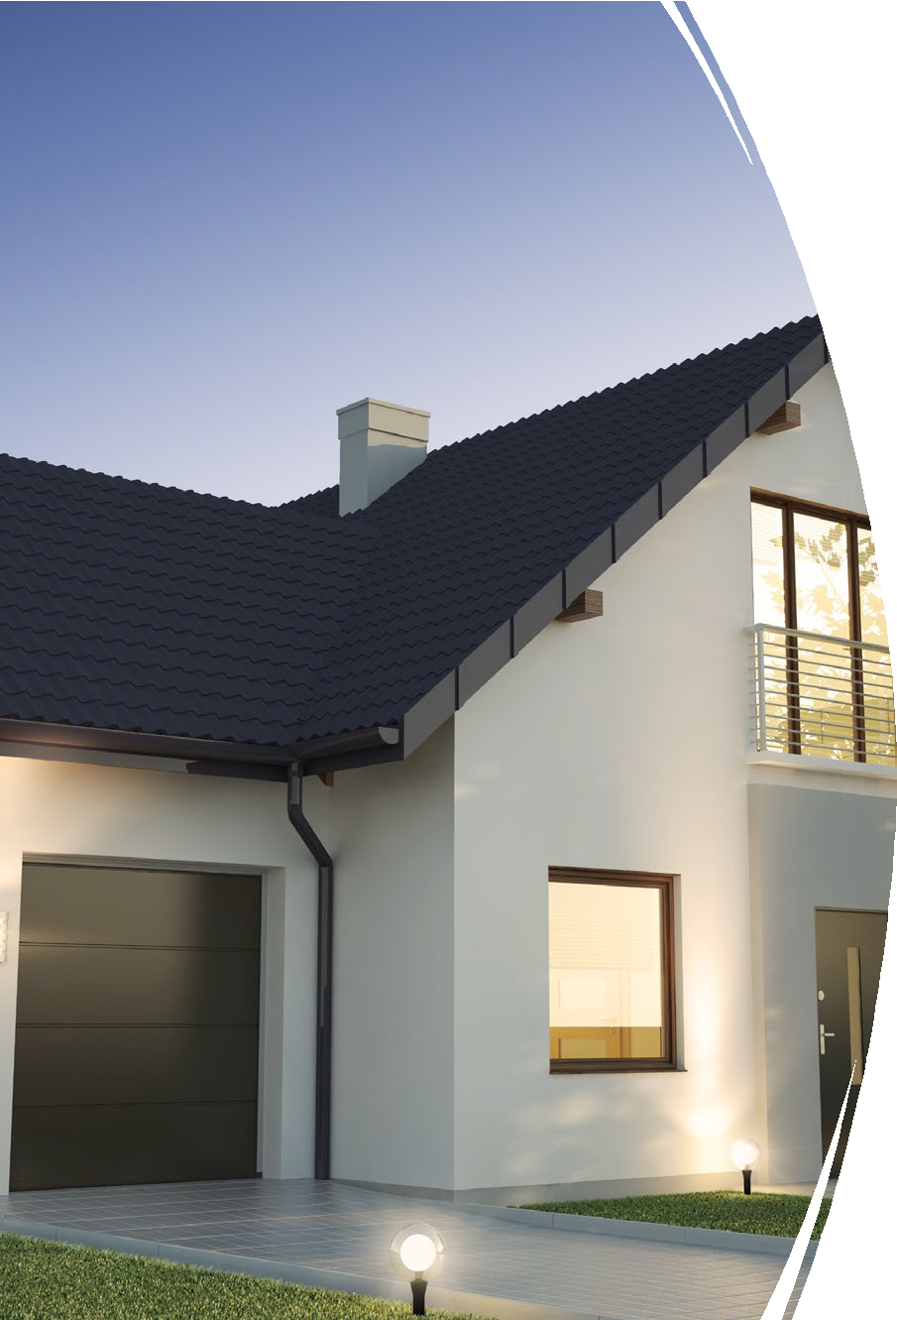
3) RESIDENTIAL EXEMPTION
The residential exemption shifts the tax burden within the residential class.
The average residential valuation for Fiscal Year 2025 is $566,931.
This exemption would allow a reduction in valuation of each qualifying residential parcel of up to 35% of the average residential valuation, ($198,426). Because the adoption of such a factor is to be borne within the residential class, the net effect of the Residential Exemption is to lower tax bills for all residential property valued less than the average valuation and increase tax bills for all residential property valued greater than the average valuation.
Such an exemption is difficult to apply due to the legal requirement that the exemption be applied only to the principal residence of the taxpayer. It is designed to provide a measure of tax relief to owner occupants of residential property by shifting the tax burden to non-domiciled residential property owners. This exemption is typically found in communities with a high percentage of second homes properties.
The Board of Assessors does not recommend this exemption.

Slide 15
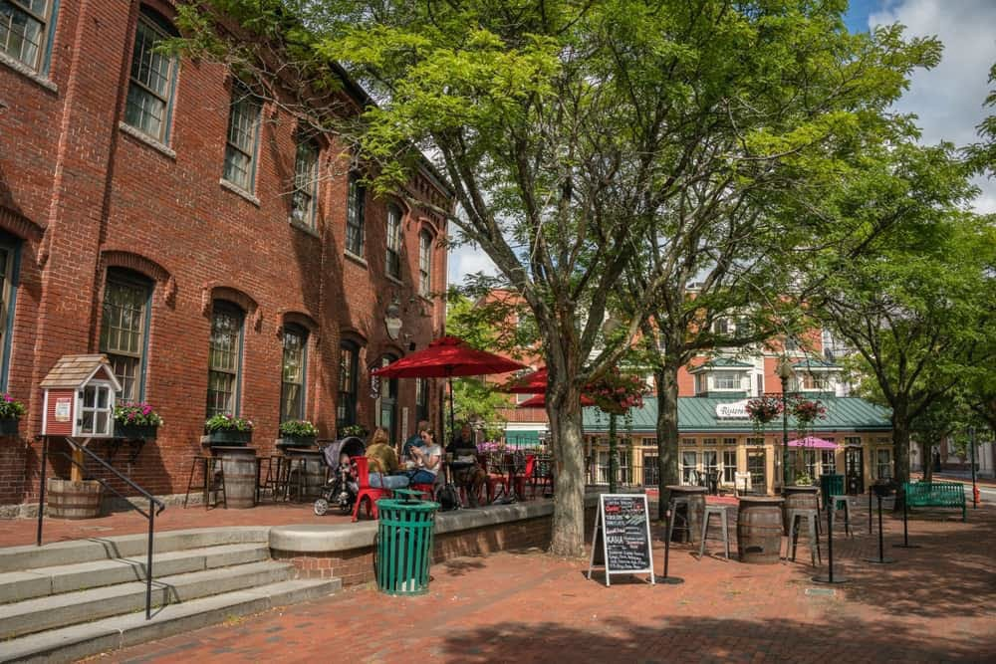
4) COMMERICAL EXEMPTION
Under General Laws Chapter 59, Section 51, the Mayor, with the approval of the City Council, may decide annually to exempt up to 10% of the value of Class 3, Commercial, parcels that are occupied by businesses with an average employment of no more than ten people at all locations during the previous calendar year, (as certified by the commission of the Department of Employment & Training). These commercial parcels must also have a valuation of less than a million dollars.
Similar to the residential exemption it results in reducing property taxes on properties occupied by small businesses and shifting those taxes onto other commercial and industrial properties.
This exemption is based on a percentage of an eligible parcel’s valuation, rather than a fixed dollar amount. If this exemption is granted our office must determine the eligible parcels, reduce their valuation by the selected Commercial and Industrial classes than for Personal Property.
The benefit of this exemption goes to the property owner rather than the business itself.
The Board of Assessors does not recommend this exemption

Slide 16
In conclusion, City Council is anticipated to vote on November 26th for:
The Residential Factor - whether there is a single tax rate or a split tax rate
An Open Space Discount – NO Open Space in Amesbury
A Residential Exemption – NO VOTE (not recommended by the Board of Assessors) and
A Commercial Exemption – NO VOTE (not recommended by the Board of Assessors)

Slide 17
Our Real Estate Exemption options for property owners enabled the City to assist 175 residents. These residents are seniors, veterans, and blind persons.
By doubling the exemption, we were able to grant approximately an additional $38,000.
CLAUSE | # OF APPS | EXEMPTION AMOUNT | TOTAL WITHOUT | TOTAL | AMOUNT FROM | % OF TOTAL
 | 2024 | FY24 | DOUBLING | GRANTED | DOUBLING
17D Senior | 23 | 319.52 | 7,348.96 | 12,284.80 | 4,935.84 | 40.18%
22(a-f) Veterans | 72 | 400.00 | 28,800.00 | 52,049.34 | 23,249.34 | 44.67%
Para | 0 | 0.00 | 0.00 |  | 0.00
22D Veteran | 10 | 75,777.98 | 75,777.98 | 75,777.98 | 0.00 | 0.00%
22E | 30 | 1,000.00 | 30,000.00 | 50,346.50 | 20,346.50 | 40.41%
37A Blind | 10 | 500.00 | 5,000.00 | 10,000.00 | 5,000.00 | 50.00%
41C Senior | 30 | 500.00 | 15,000.00 | 24,898.81 | 9,898.81 | 39.76%
 | 175 |  | 161,926.94 | 225,357.43 | 63,430.49 | 28.15%
We had a total of 175 granted real estate exemption applications for FY24
Total amount without doubling was aprox $161,927
Total amount granted was aprox $225,357
Total amount from doubling the exemptions was $38,195

Slide 18
If you have any questions please feel free to call or email our office 978-388-8102
assessor@amesburyma.gov
THANK YOU!

